Slide 1
SURPLUS PRODUCTION MODELS AND THE RESULTING
REFERENCE POINTS USED IN
FISH STOCK ASSESSMENT
Joseph T. DeAlteris
University of Rhode Island
Kingston, RI

Slide 2
Outline of Presentation
Purpose
Modeling population growth and regulation
Surplus production model
Reference points
Limitations of Equilibrium Surplus Production Models
Surplus production models applied to US east coast species
Conclusions

Slide 3
Modeling Population Growth and Regulation
Density independent: birth and death rates are constant over a range of population sizes.
Density dependent: birth and death rates are linearly proportional to population size.

Slide 4
Density Independent Population Growth (No Environmental Limitations)
Intrinsic rate (r) of population growth or decay is equal to the difference between birth (b) and death (d) rates.
Rate of change of population numbers (dN/dt) is equal to the product of population number (N) and its intrinsic rate of growth.

Slide 5
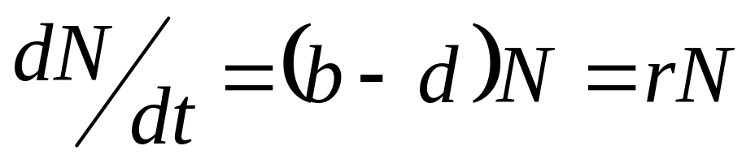
Density Independent Population Growth
Where: b = birth rate
d = death rate
r = intrinsic rate of growth or decay

Slide 6
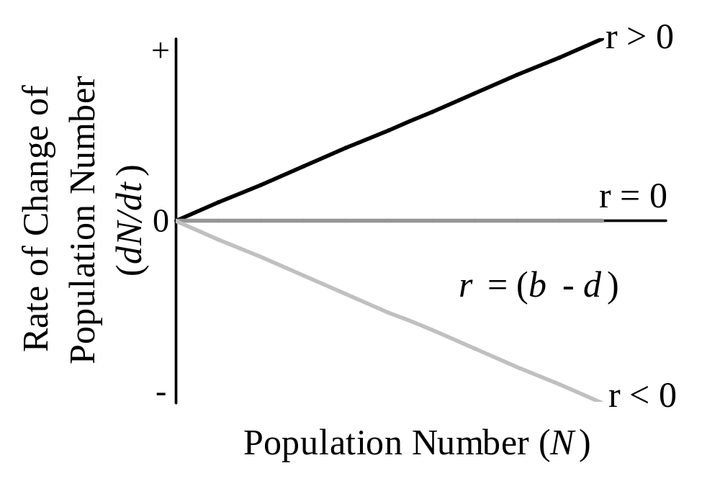
Rate of Change of Population Number (dN/dt) as a Function of Population Size (N)

Slide 7
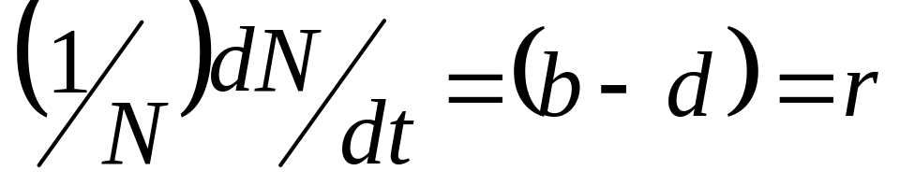
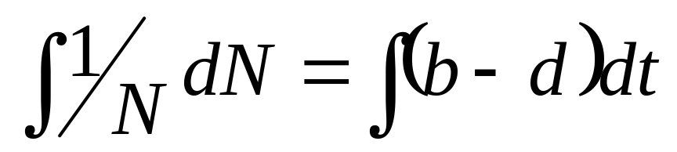
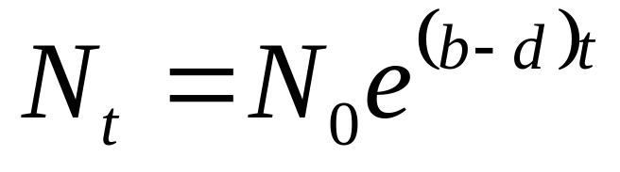
Solving the Differential Equation

Slide 8
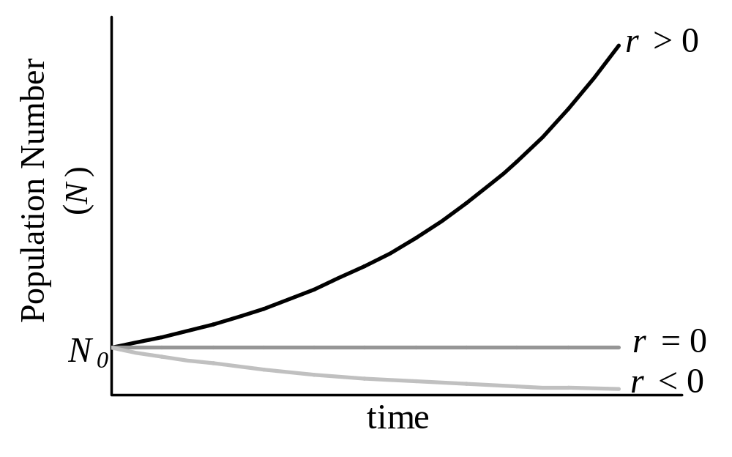
Population Trajectories for Density Independent Growth

Slide 9
Density Dependent Population Growth (Environmental Limitations)
Birth and death rates are dependent on population size.
Rate of change of population number (dN/dt) is zero at small and large population numbers and is maximum at mid-range population numbers.

Slide 10
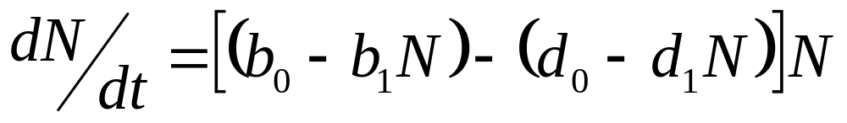
Density Dependent Population Growth
Where: b₀ and d₀ are the rates at N = 0, and
b₁ and d₁ are the population dependent
coefficients

Slide 11
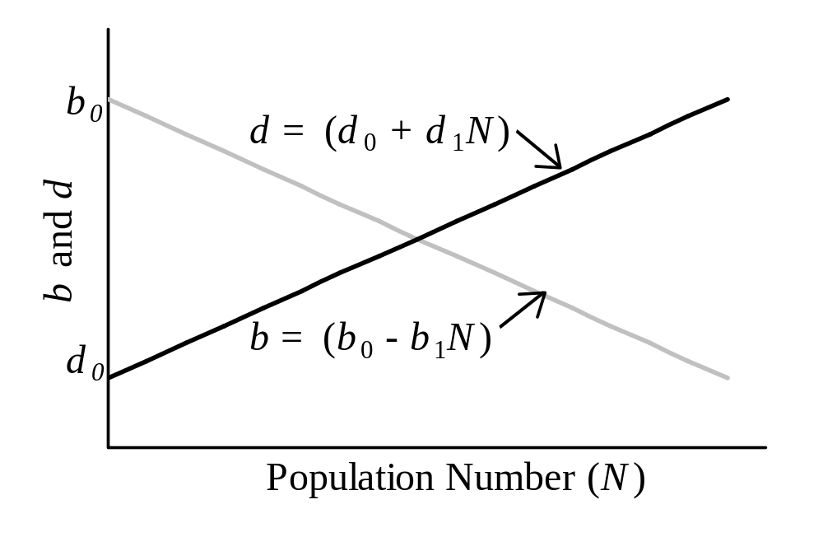
Birth (b) and Death (d) Rates Incorporating Density Dependence

Slide 12
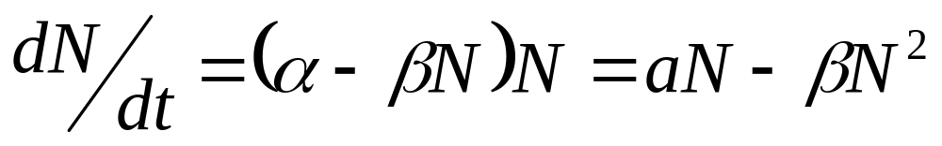
Population Rate of Change as a Function of Population Size
Where: α is the initial birth and death rates
β is the density dependent birth an death rates

Slide 13
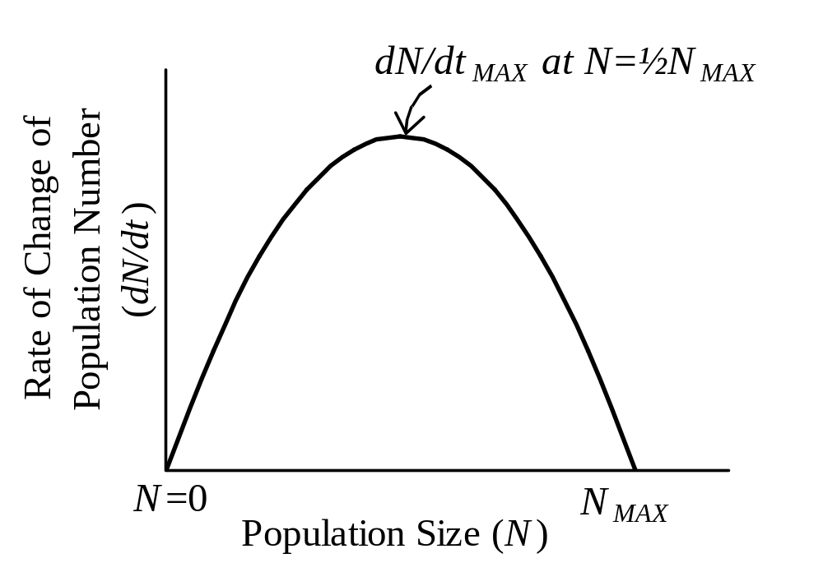
Parabolic Model Relating Density Dependent Rate of Population Change to Population Size

Slide 14
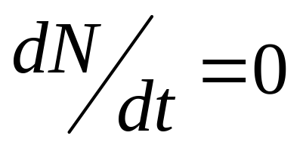
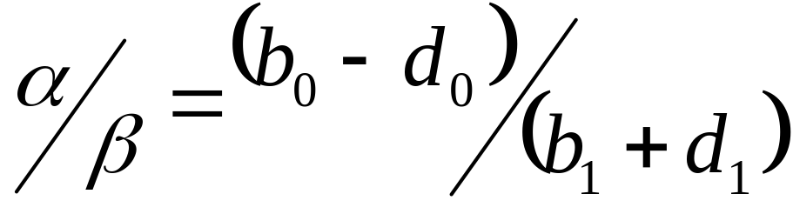
Characteristics of the Parabolic Model
At N = 0,
At N_{MAX},
N_{MAX} =

Slide 15
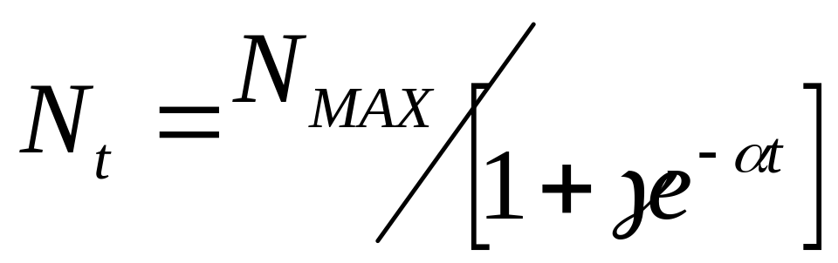
Solving the Differential Equation

Slide 16
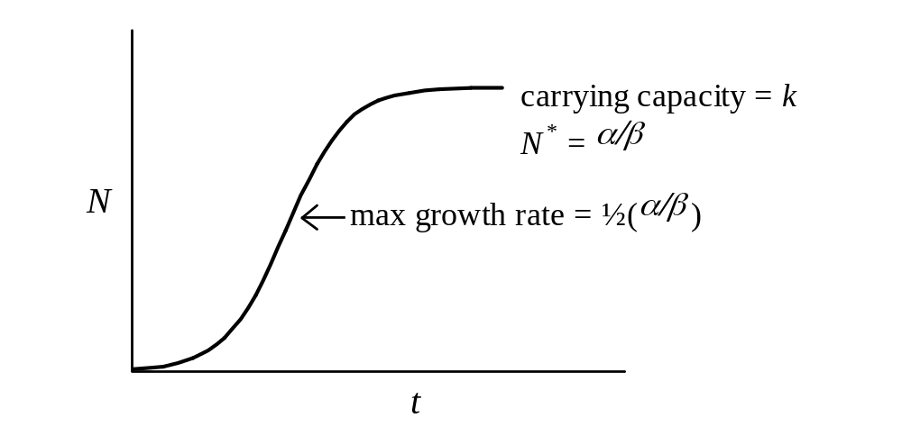
Logistic Model Describing Population Number as a Function of Time

Slide 17
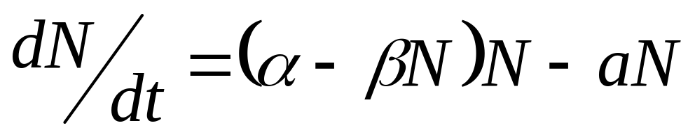
Addition of Anthropogenic Mortality
Where: a is a coefficient or rate of anthropogenic removal that can be equated to a fishing mortality rate.

Slide 18
Characteristics of Surplus Production Models
Equilibrium and non-equilibrium models.
Global model: does not distinguish between recruitment, growth, and mortality.
Not structured: does not consider age or length groups.
Utilize biomass instead of number for ecological considerations.

Slide 19
Surplus Production Model:
Basic Concept
New Biomass = Old Biomass + Recruitment +
Growth - Catch - Natural Mortality
New Biomass = Old Biomass + Surplus Production – Catch
At equilibrium: New Biomass = Old Biomass
∴ Catch = Surplus Production

Slide 20
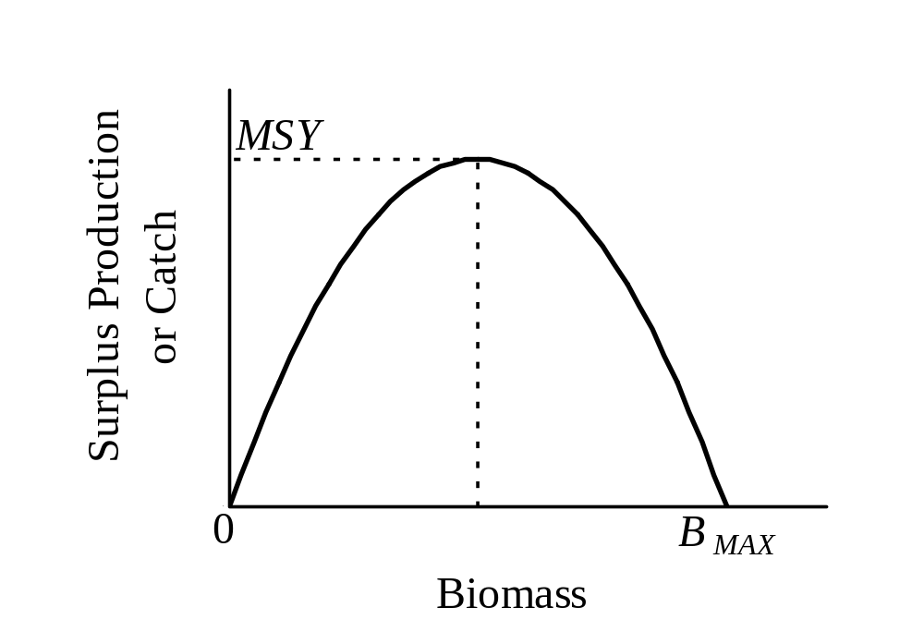
Surplus Production Model

Slide 21
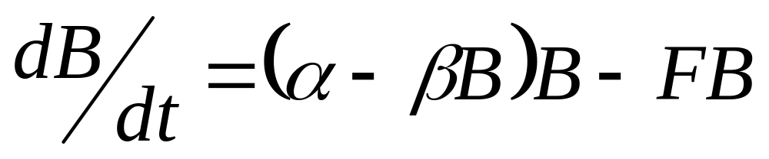
Schaefer Model

Slide 22
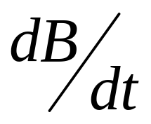
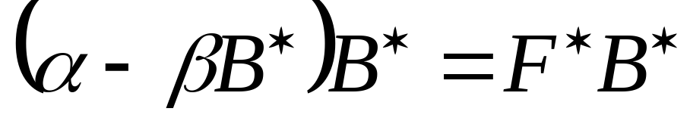
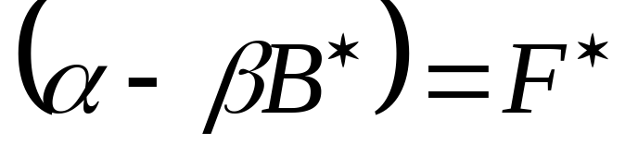
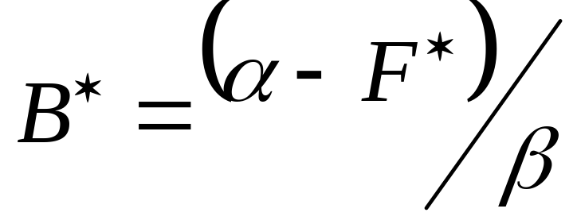
At equilibrium = 0, therefore:
Where: B* represents equilibrium levels of biomass at specific equilibrium levels of fishing mortality (F*).

Slide 23
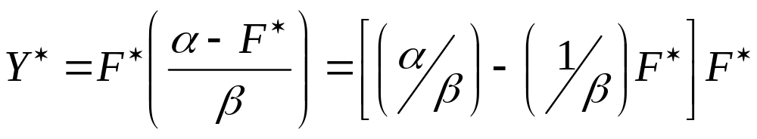
If: Y* = F* B*
Then substituting:

Slide 24
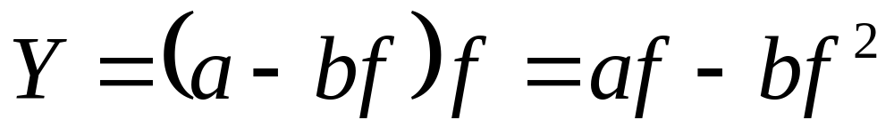
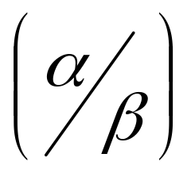
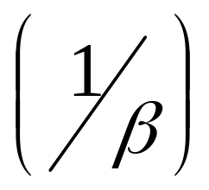
Generalized Schaefer Model (1954)
Where: a is
b is
f is F, assuming catchability is
constant (based on F = fq)

Slide 25
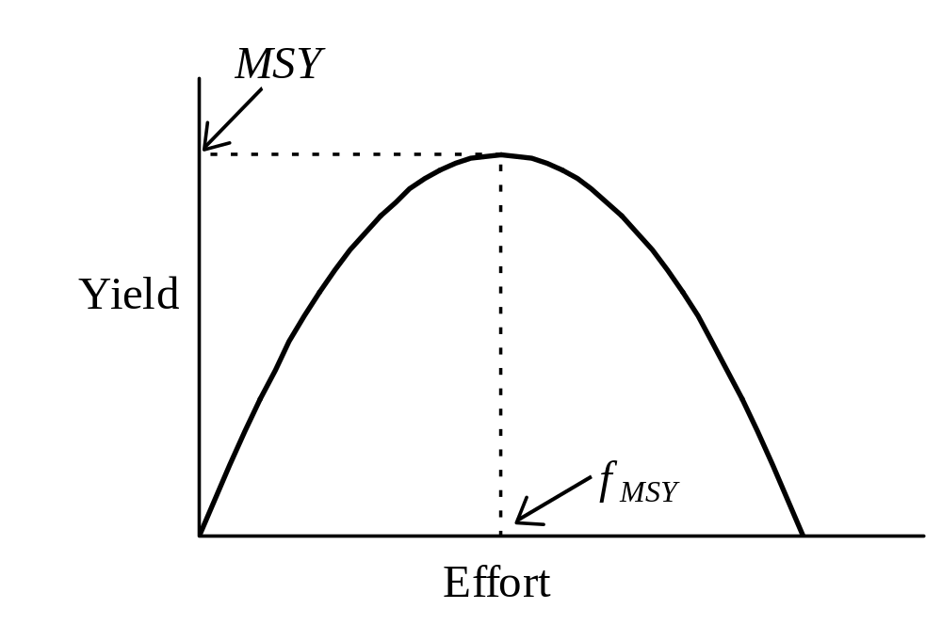
Schaefer (1954) Model

Slide 26
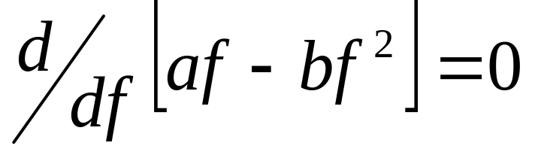
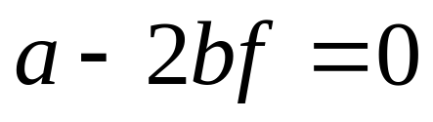
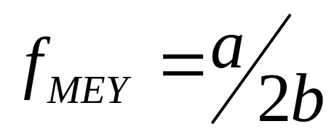
Taking the derivative of the parabolic function:

Slide 27
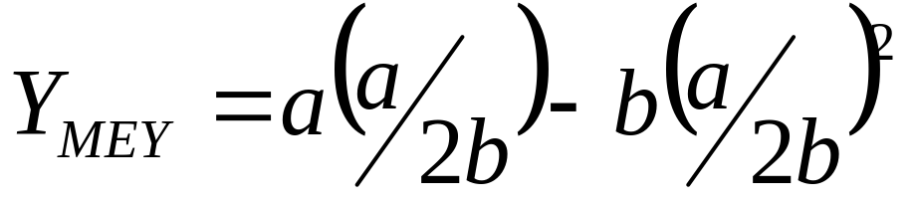
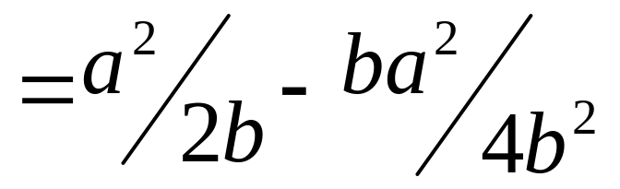
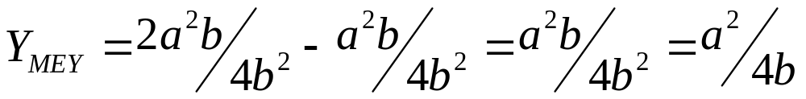
Substituting:

Slide 28
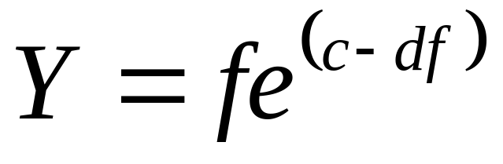
Fox Model

Slide 29
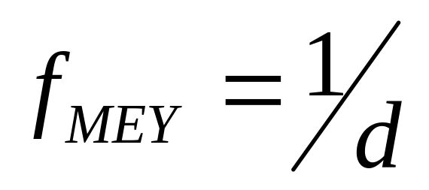
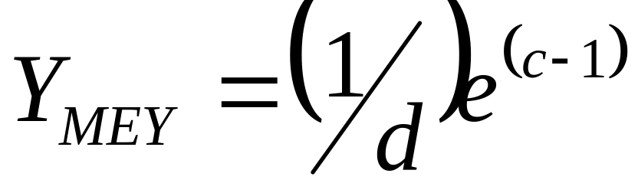
Fox Model

Slide 30
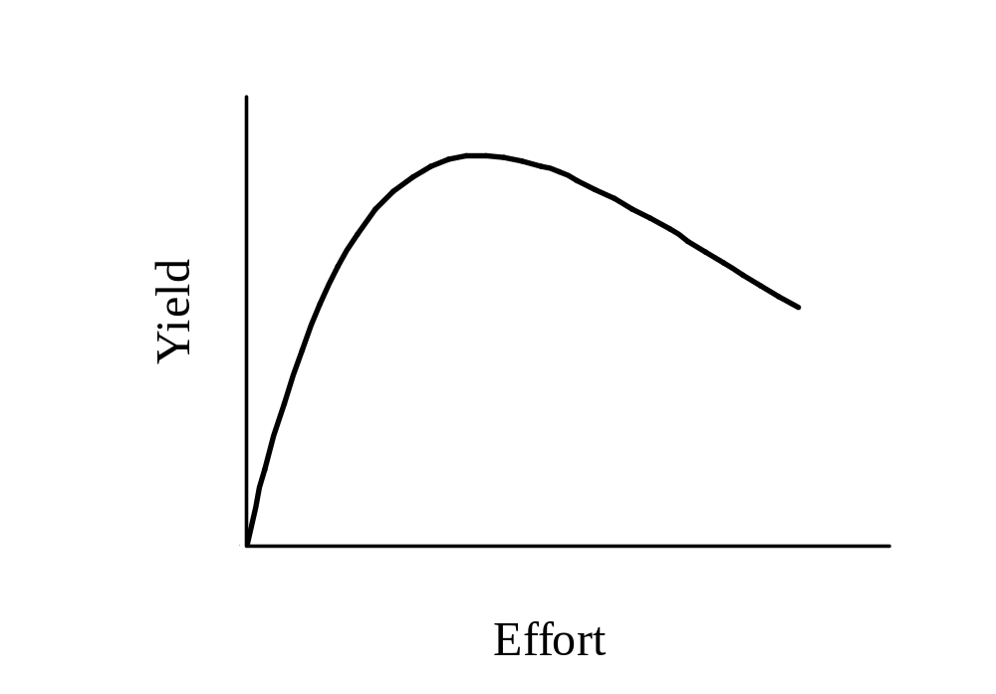
Fox (1970) Model

Slide 31
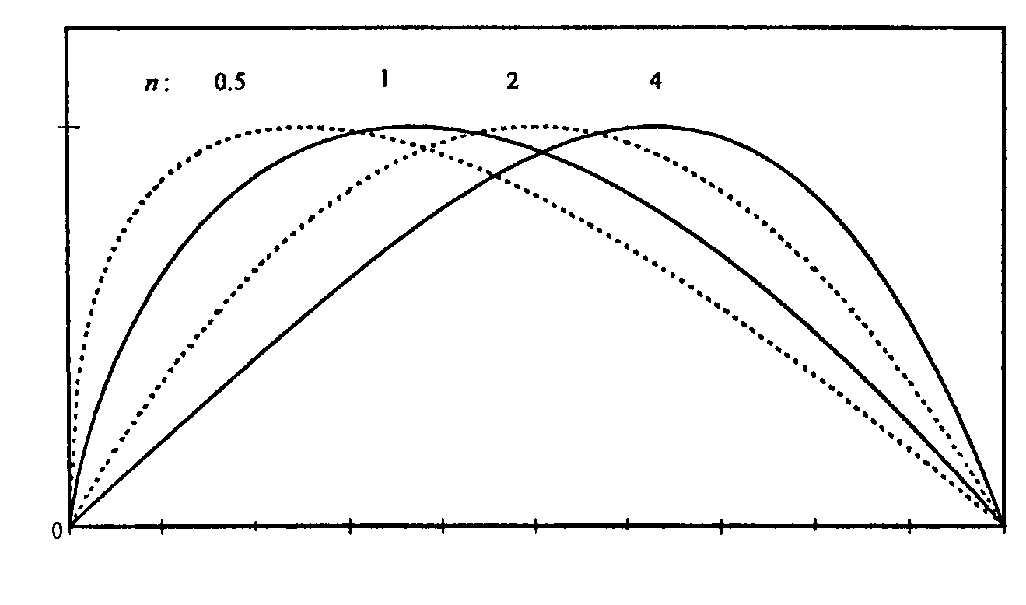
Pella and Tomlinson (1969) Model
Yield
Effort

Slide 32
Reference Points: Target vs. Limit
MSY – maximum sustainable yield, largest average catch that can be taken continuously from a stock under average environmental conditions.
B_{MSY} – the level of stock biomass that will produce MSY.
f_{MSY} – the level of fishing effort that will produce MSY.
²/₃ f_{MSY} – a precautionary target used so as to avoid overfishing, generally provides greater than 85% MSY.

Slide 33
Application of Theory to Data
Consider the following time series of catch and effort data for a trawl fishery. Determine MSY and effort at MSY using the Schaefer model.

Slide 34
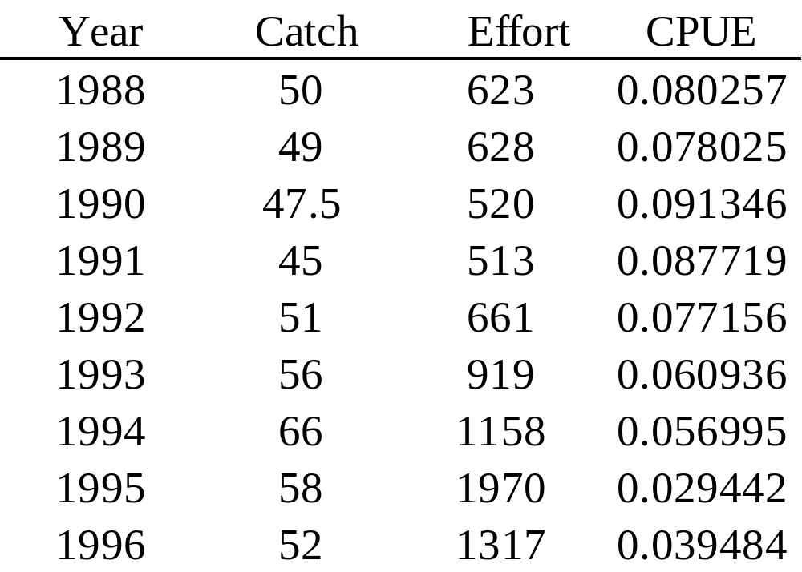
Trawl Catch and Effort Data with Derived CPUE

Slide 35
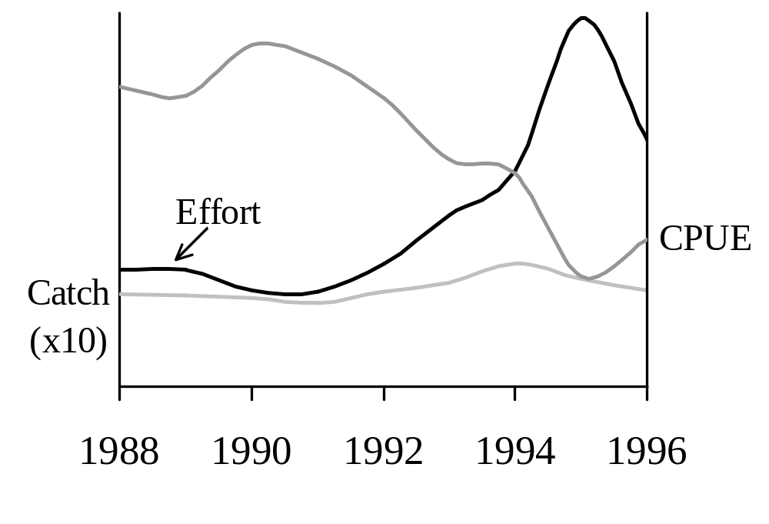
Time Series of Catch, Effort, and CPUE

Slide 36
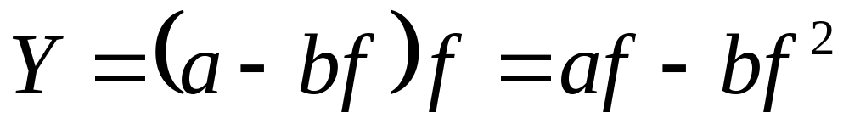
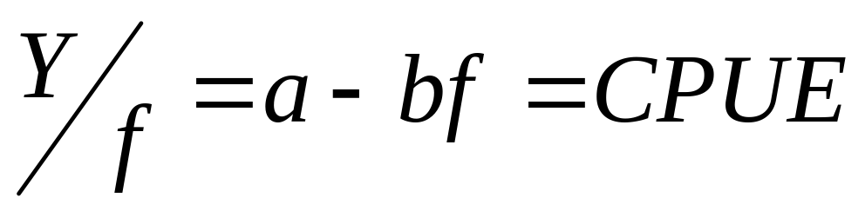
Parabolic Yield Function:
Linearized Yield Function:

Slide 37
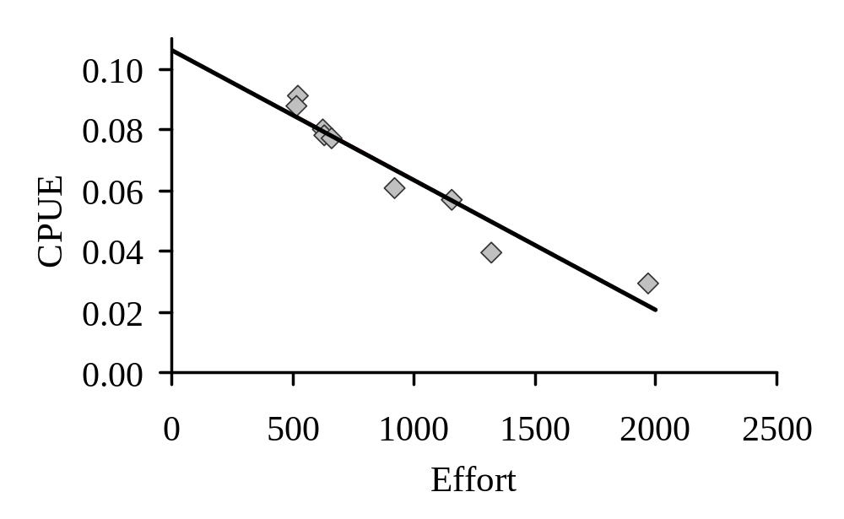
Plot of CPUE versus Effort

Slide 38
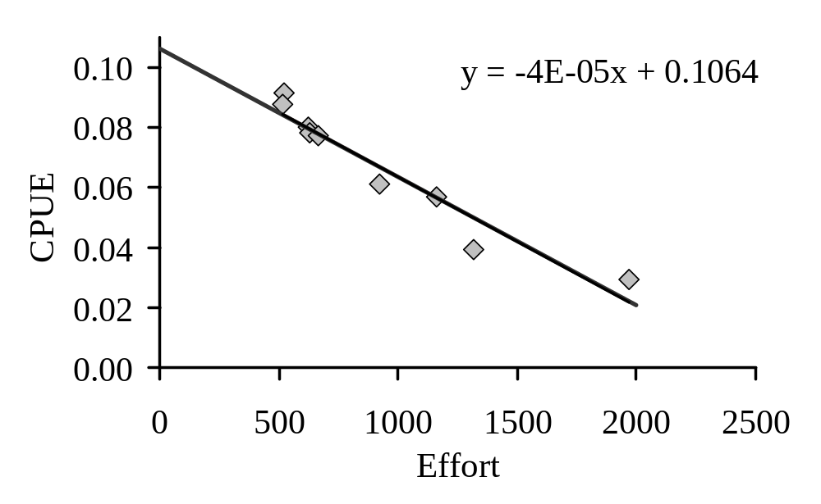
Plot of CPUE versus Effort
b
a

Slide 39
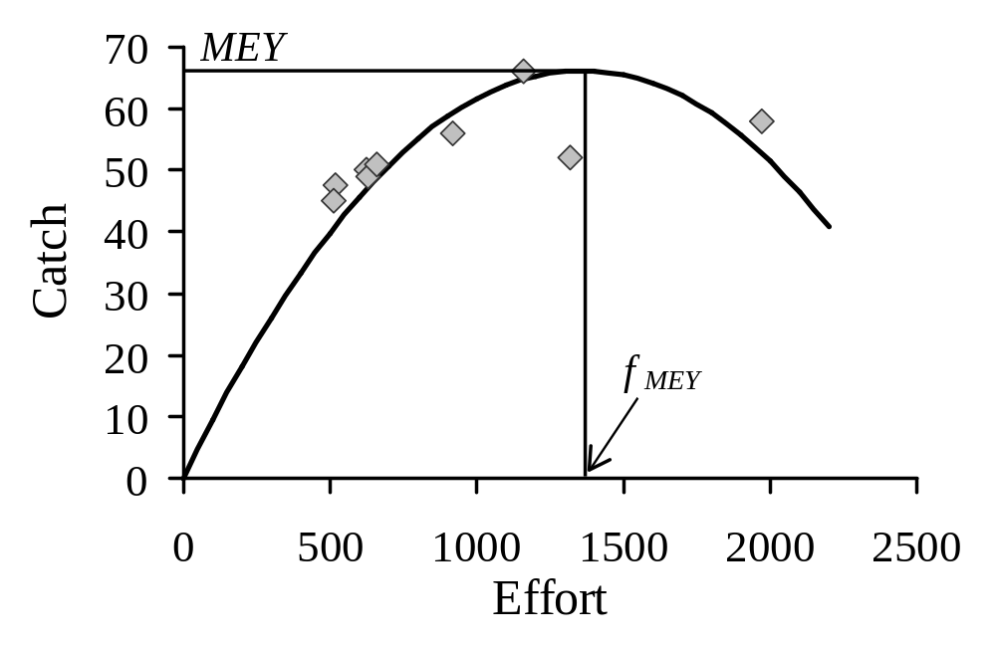
Non-linear Schaefer Model Best Fit to the Catch and Effort Data
a = 0.1063
b = 0.000043

Slide 40
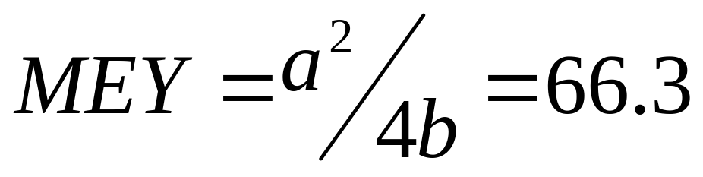
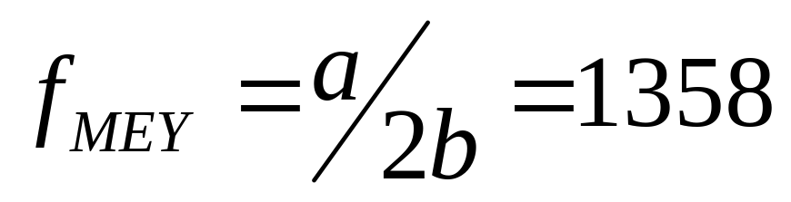
Estimating MEY and f_{MEY}

Slide 41
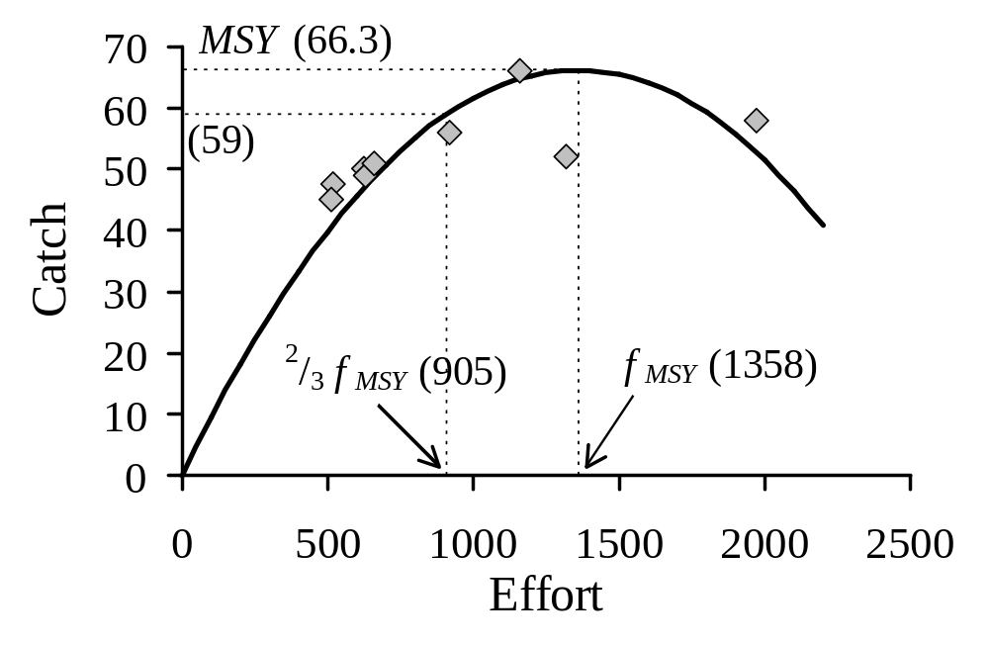
Non-linear Schaefer Model Best Fit to the Catch and Effort Data

Slide 42
Limitations of Equilibrium Surplus Production Models
Fish stocks are rarely at equilibrium due to environmental variability and stock abundance fluctuation.
Equilibrium models usually overestimate MSY and f_{MSY} whenever applied to data collected on a stock in decline, i.e. during development of the fishery.
MSY and f_{MSY} post stock rebuilding are substantially lower than those predicted based on data collected during the process of fishing down an accumulated biomass.

Slide 43
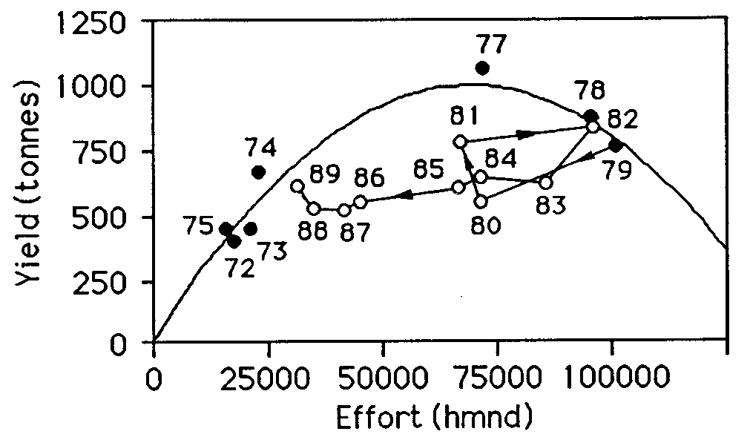
Schaefer Model for Sea Bass (1972 – 1989)

Slide 44
Surplus Production Models Applied to East Coast Species
Lobster
Bluefish
Blue Crab
Summer Flounder

Slide 45
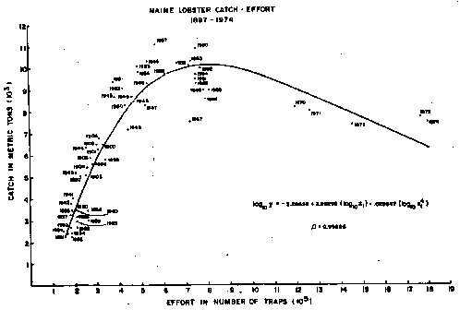
Maine Lobster Catch-Effort
1897-1974
Notes:
Catch and effort data for the Maine lobster fishery from the period 1897 to 1974 demonstrated the classic curve that depicts increasing yield with increasing effort until some maximum is reached, after which increases in effort produce declining yields.
In more recent years the yield curve for the Maine lobster fishery has turned upwards again, in spite of increasing effort. But there are questions about the comparability of data. For example, if the fishing grounds expanded, the curve would no longer hold.

Slide 46
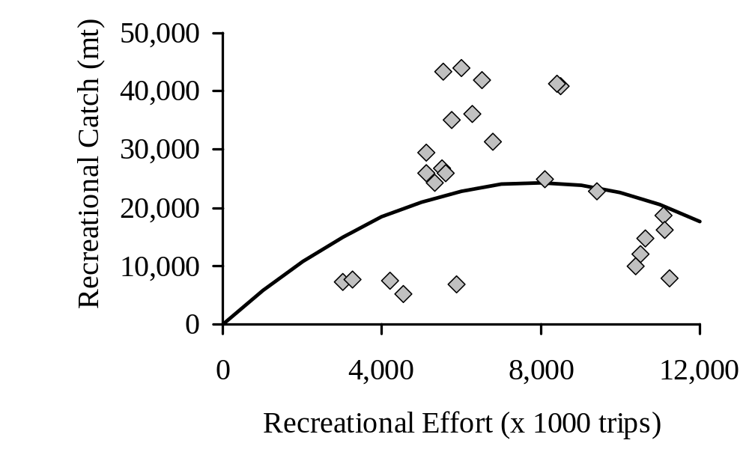
Schaefer Model for Bluefish (1974 – 1999)

Slide 47

Schaefer Model for Blue Crab (1945 – 1995)

Slide 48

Fox Model for Summer Flounder from the North Carolina Winter Trawl Fishery (1982 – 1990)

Slide 49
Conclusions
Maximum production and therefore maximum catch is possible only at mid-range population size.
Biological reference points are MSY, B_{MSY}, and f_{MSY}.
Equilibrium surplus production models must be applied cautiously as they tend to overestimate MSY and f_{MSY}.

